Slide 1
Data observability
Pravin Y Pawar
Adapted from What is Data observability? The five pillars
By Barr Moses

Slide 2
Observability
Observability is no longer just for software engineering!
With the rise of data downtime and the increasing complexity of the data stack,
observability has emerged as a critical concern for data teams, too.
Developer Operations (DevOps) teams have become an integral component of most engineering organizations
remove silos between software developers and IT, facilitating the seamless and reliable release of software to production
As organizations grow and the underlying tech stacks powering them become more complicated
it’s important for DevOps teams to maintain a constant pulse on the health of their systems
Observability, a more recent addition to the engineering lexicon, speaks to this need, and refers to the monitoring, tracking, and triaging of incidents to prevent downtime.

Slide 3
Observability engineering
As a result of this industry-wide shift to distributed systems,
observability engineering has emerged as a fast-growing engineering discipline
At its core, observability engineering is broken into three major pillars:
Metrics refer to a numeric representation of data measured over time
Logs, a record of an event that took place at a given timestamp, also provide valuable context regarding when a specific event occurred
Traces represent causally related events in a distributed environment
Taken together, these three pillars give DevOps teams valuable insights to predict future behavior
and in turn, trust their system to meet SLAs

Slide 4
The rise of data downtime
Common phenomenon
Most of the time a report is delivered, only to be notified minutes later about issues with data
didn’t matter how strong data pipelines were or how many times reviewed SQL: data just wasn’t reliable!
Data downtime tops the list of the problems!
periods of time when data is partial, erroneous, missing, or otherwise inaccurate
only multiplies as data systems become increasingly complex, supporting an endless ecosystem of sources and consumers
For data engineers and developers, data downtime means wasted time and resources
For data consumers, it erodes confidence in decision making

Slide 5
Data observability
Instead of putting together a holistic approach to address data downtime,
teams often tackle data quality and lineage problems on an ad hoc basis
much in the same way DevOps applies observability to software
Data observability refers to an organization’s comprehensive understanding of the health and performance of the data
within their systems.
Data observability tools employ
automated monitoring,
root cause analysis,
data lineage,
and data health insights
to proactively detect, resolve, and prevent data anomalies
Results in
healthier data pipelines,
increased team productivity,
enhanced data management practices,
and ultimately, higher customer satisfaction

Slide 6
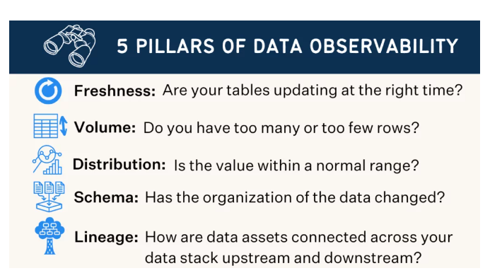
Five pillars of data observability
Together, these components provide valuable insight into the quality and reliability of data.

Slide 7
Five pillars of data observability(2)
Freshness
seeks to understand how up-to-date your data tables are, as well as the cadence at which your tables are updated
is particularly important when it comes to decision making
after all, stale data is basically synonymous with wasted time and money
Quality
Data pipelines might be in working order but the data flowing through them could be garbage
looks at the data itself and aspects such as percent NULLS, percent uniques and if data is within an accepted range
gives insight into whether or not tables can be trusted based on what can be expected from data
Volume
refers to the completeness of data tables and offers insights on the health of data sources
If 200 million rows suddenly turns into 5 million, should know why

Slide 8
Five pillars of data observability(3)
Schema
Changes in the organization of data, in other words, schema, often indicates broken data
Monitoring who makes changes to these tables and when is foundational to understanding the health of data ecosystem
Lineage
When data breaks, the first question is always “where?”
Data lineage provides the answer by telling
which upstream sources and downstream ingestors were impacted,
which teams are generating the data
and who is accessing it
Good lineage also collects information about the data (also referred to as metadata)
speaks to governance, business, and technical guidelines associated with specific data tables
serving as a single source of truth for all consumers

Slide 9
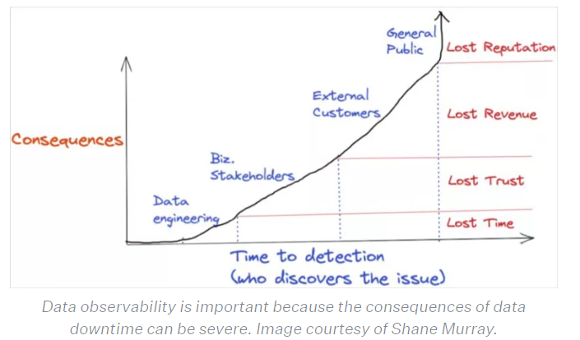
Why is data observability important?
For data engineers and developers, data observability is important because data downtime means wasted time and resources
For data consumers, it erodes confidence in your decision making

Slide 10
The key features of data observability tools
“what are data observability tools?”
Connects to existing stack quickly and seamlessly and does not require modifying your data pipelines, writing new code, or using a particular programming language
allows quick time to value and maximum testing coverage without having to make substantial investments
Monitors data at-rest and does not require extracting the data from where it is currently stored
allows the data observability solution to be performant, scalable and cost-efficient
Requires minimal configuration and practically no threshold-setting
should use machine learning models to automatically learn environment and data
uses anomaly detection techniques to let know when things break
minimizes false positives by taking into account not just individual metrics, but a holistic view of data and the potential impact
Requires no prior mapping of what needs to be monitored and in what way
helps identifying key resources, key dependencies and key invariants to get broad data observability with little effort
Provides rich context that enables rapid triage and troubleshooting, and effective communication with stakeholders impacted by data reliability issues
shouldn’t stop at “field X in table Y has values lower than Z today.”
Prevents issues from happening in the first place by exposing rich information about data assets
so that changes and modifications can be made responsibly and proactively

Slide 11
The future of data observability
Data observability is a rapidly maturing but still evolving space
For example, G2 Crowd created a data observability category in late 2022,
but there is not a data observability Gartner Magic Quadrant
But Gartner did place data observability on their 2022 Data Management Hype Cycle!
However, multiple companies and technologies are identifying with the term data observability
has been tremendous investor activity, and, most importantly, customer interest and values are at all-time highs
Data observability is at the heart of the modern data stack,
whether it’s enabling more self-service analytics and data team collaboration, adoption,
or working alongside dbt unit tests and Airflow circuit breakers to prevent bad data from entering the data warehouse (or data lake) in the first place
A core component of important and emerging data quality best practices such as data mesh, data SLAs, and data contracts

Slide 12
Thank You!
In our next session:

